Slide 1
UWP (… or mostly XAML...)
Einar Ingebrigtsen
Technical Evangelist, DX

Slide 2
XAML
Based on WPF (Windows Presentation Foundation)
Layout is by default not flowing – unlike HTML
Active view
Observing capabilities
Declarative binding
Declarative hookup of actions

Slide 3
Dependency Object
Base type for all elements that can sits inside XAML
Can hold dependency properties…

Slide 4
Dependency Property
Capable of binding to properties
Properties are registered on a DependencyObject
Callback when property changes
Sits as part of a property bag on a DepdencyObject

Slide 5
Attached Dependency Property
Same as Dependency Property
… except for; it can be attached to any object – “extending types”
Examples
Validation
Augmenting with new functionality making it declaratively available – maintaining concerns

Slide 6
Routed Events
Bubbles up the hierarchy (VisualTree)
Holds information about the original source
Examples: Focus, LostFocus

Slide 7
ContentControl
Base class for all controls that has content
Can only have one element as content
Examples: TextBlock, Button

Slide 8
ItemsControl
Base class for controls that has items
Items can be templated; DataTemplate
Items can be provided through Binding
ItemsPanelTemplate defines the panel wrapping the items
Examples: ListBox, ComboBox

Slide 9
Resources
ALL UIElements can have resources available for their scope
Application level resources (App.xaml)
Hierarchical
A resource can be anything, even a CLR object
Most often used for Styling and templating and storing of reusable objects

Slide 10
Resource Dictionaries
Resources are represented as Key/Value in a dictionary
MergedResourceDictionary gives you the ability to include dictionaries from other files

Slide 11
Styling
Styles can change any property, not only visual properties. Anything exposed on any object
Must specify target type
Implicit Styling
No key just a target type
Inheritance - BasedOn

Slide 12
Control Templating
You can alter the entire look and feel
Can be set directly on a control when used or as a style – even implicitly for all instances of the target type

Slide 13
Visual States

Slide 14
Layout
Grid
StackPanel
RelativePanel
Viewbox

Slide 15
User Controls
XAML + Code Behind
Useful for breaking up the monolith into composable pieces

Slide 16
DataContext
All FrameworkElements has a DataContext
Hierarchical
Children inherits DataContext from parent unless explicitly set

Slide 17
Binding
Markup extension - {Binding …}
Can specify source unless you want it to be relative to the DataContext
Path property specifies the property path relative to the source
Mode
OneWay (default), TwoWay, OneTime
ValueConverter
FallbackValue
TargetNullValue
Can use another element as source (ElementName)

Slide 18
Active View
INotifyPropertyChanged
INotifyCollectionChanged
Concrete implementation: ObservableCollection<>
New: IObservableMap<> and IObservableVector<>

Slide 19
MVVM

Slide 20
MVVM
Behavior
Business logic relevant to the frontend without knowing about the view
Can be connected to the server or 3rd party dependencies outside the realm of the view+viewModel
Represented as commands (by default)
State
Model
App logic state

Slide 21
MVVM WHY
Separate the concerns – make things clearer
View is great at view concerns
ViewModel is great at holding state and exposing behaviors
Promotes cleaner code
Testable
Perfect match for XAML based platforms

Slide 22
Event Aggregator

Slide 23
Triggers / Actions (when I push the door-handle, the door opens)
Declaratively defined in the View
Somethings Triggers
Performs an action
A package dependency away (Microsoft.Xaml.Behaviors.Uwp.Managed)

Slide 24
Behaviors
Simple explanation: Multiple Triggers, one end action
Example: Drag and drop

Slide 25
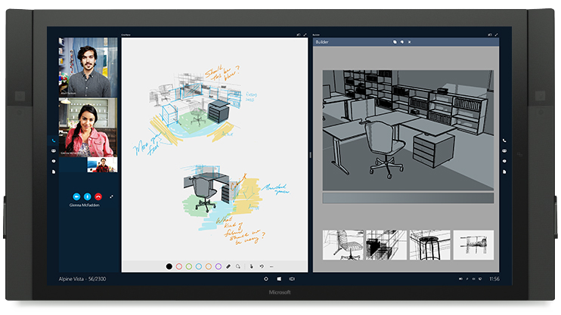
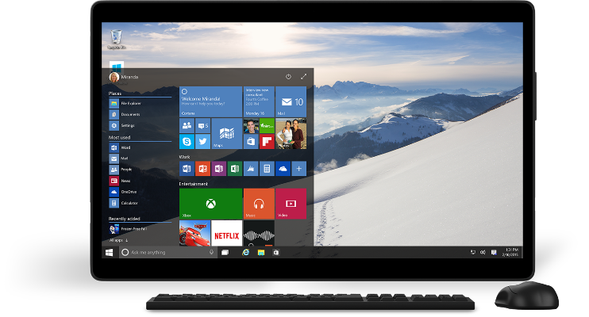
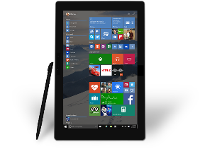
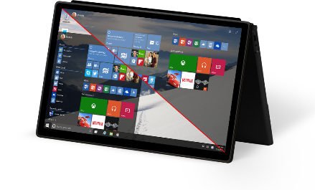
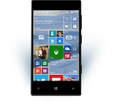
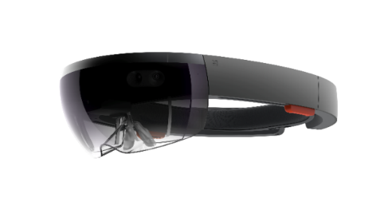
UWP in Windows 10
Windows 10 Goal: Increase reach and opportunity
UWP Goal: Reduce developer cost to deliver on the increased opportunity

Slide 26
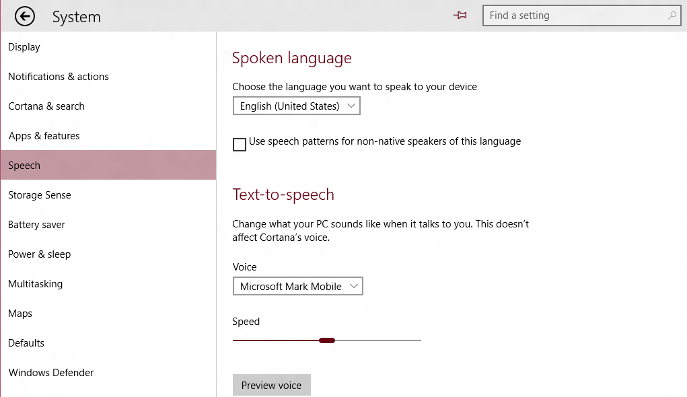
This Session: XAML UI
The “Native” UI Framework for Windows 10 Apps and Experiences
Supports C++ or C#/VB
<!-- XAML Outline -->
<Page>
<StackPanel Orientation="Horizontal">
<AppBarButton/>
<AutoSuggestBox/>
</StackPanel>
<Grid>
<ListView/>
<TextBlock Text="Spoken Language"/>
<ComboBox/>
<CheckBox/>
<Slider/>
<Button/>
</Grid>
</Page>

Slide 27

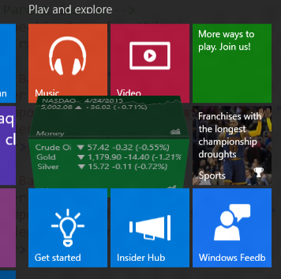
XAML in Windows 10: Beyond UW Apps New/enhanced controls, performance, much more…
We are listening…

Slide 28
Getting to Universal Windows Controls

Slide 29
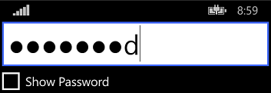

“Universal” Controls in 8.1 Some differences in look, feel and APIs
Windows 8.1 Desktop
Phone 8.1 (Blue)

Slide 30

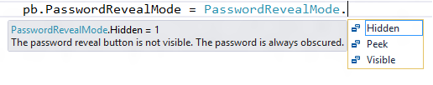
Upgrading to Windows 10 But, that also means some things had to change
IsPasswordRevealButtonEnabled in 8.1 (bool value)

Slide 31
Newly Universal Controls

Slide 32


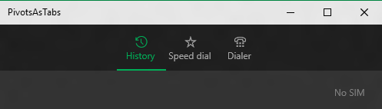
Newly Universal Controls: Pivot Great for 1-handed on Mobile, Tabs on desktop

Slide 33
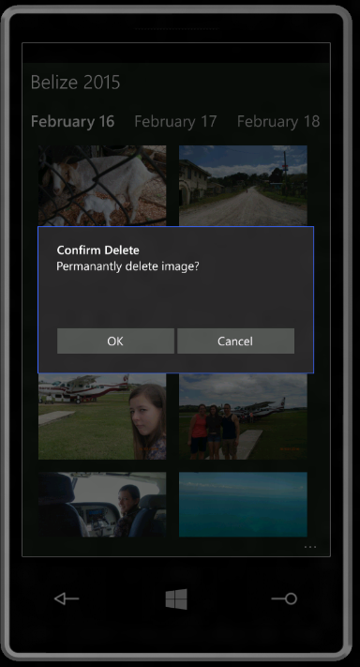
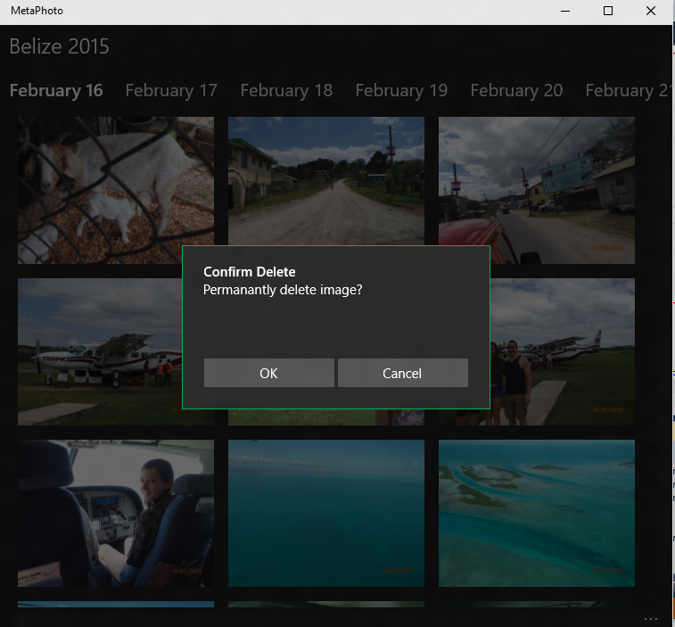
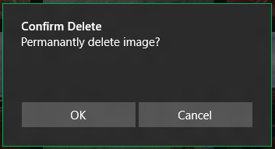
Newly Universal Controls: ContentDialog App model, XAML child content

Slide 34
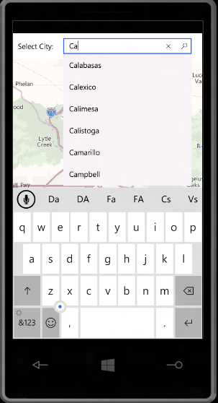
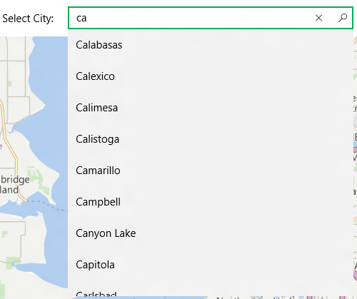
Newly Universal Controls: AutoSuggestBox And IME support, glyph

Slide 35
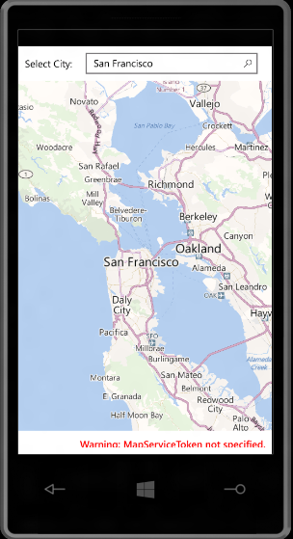
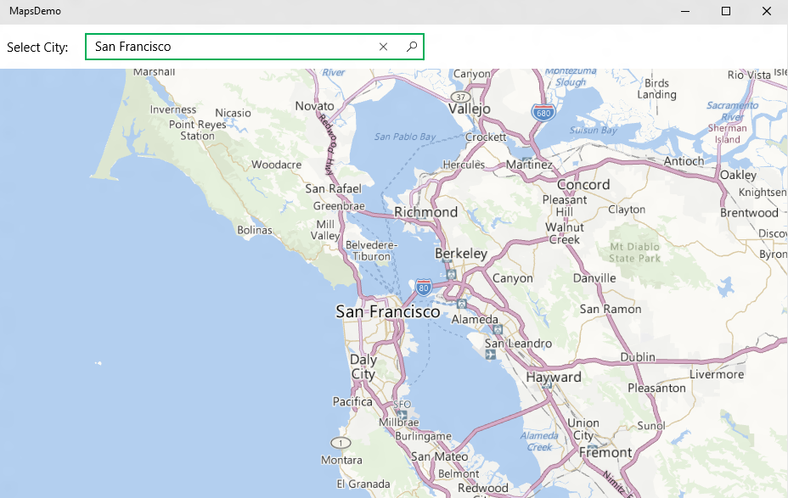
Newly Universal Controls: Maps Plus Offline, 3D, Street Side Panoramas

Slide 36
Using XAML to Build UW Apps It’s more than just universal controls

Slide 37
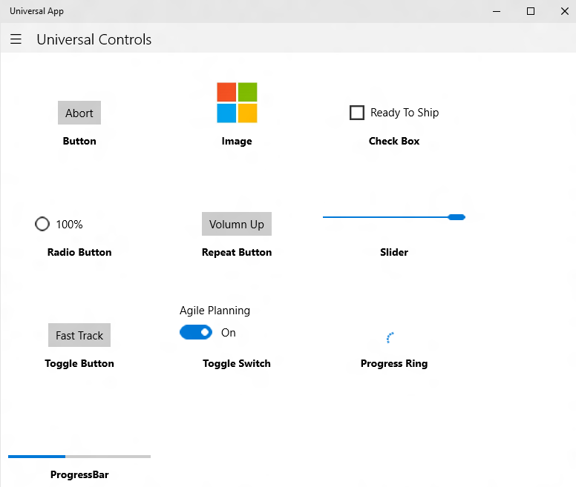


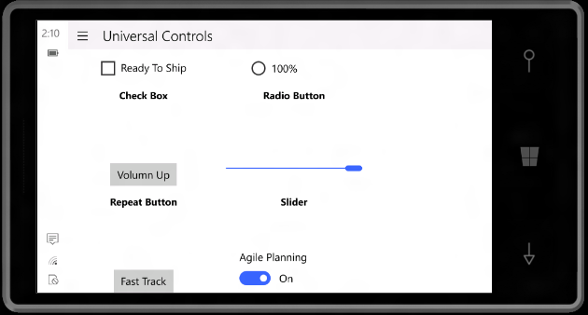

Common Controls Common Branding, Behavior, Scaling, Support Diverse Inputs

Slide 38
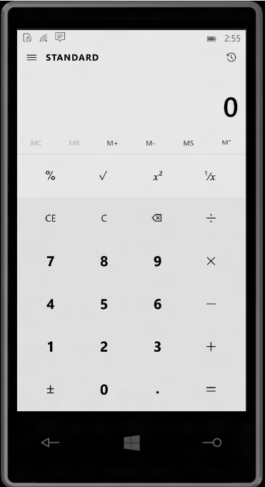
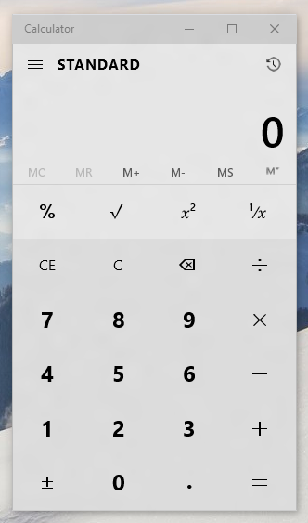
Controls Reusable Across Devices/Displays Views may be reusable (but likely to need tailoring)

Slide 39
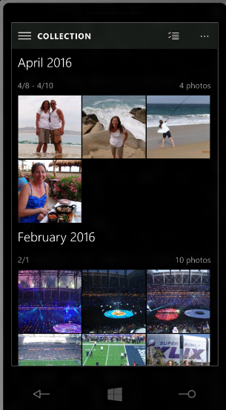
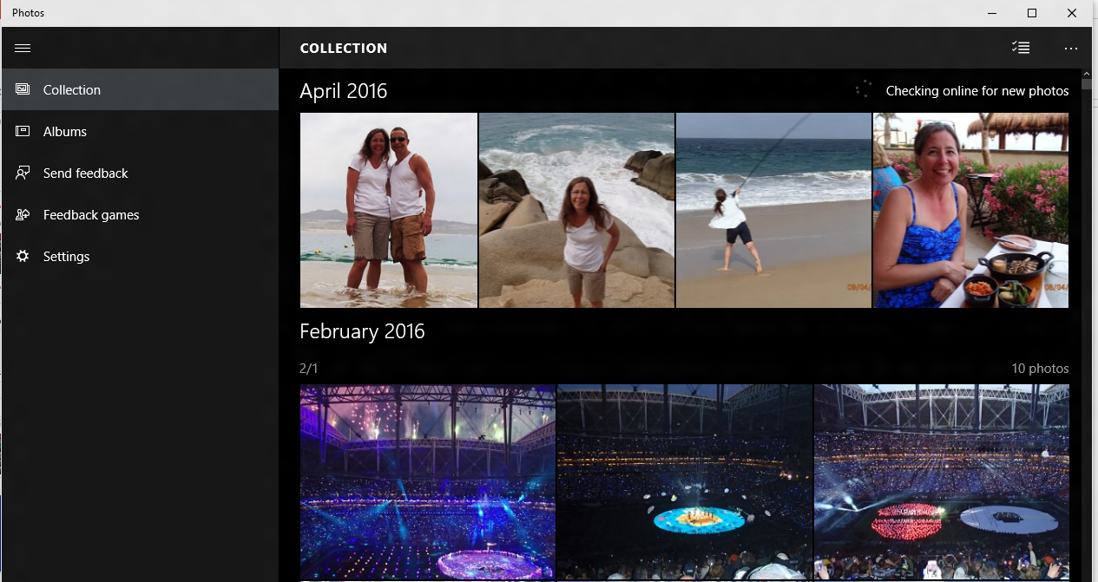
Tailoring App Experiences Typically via responsive pages or multiple views
Windows 10 has new features to help with responsive designs

Slide 40
New XAML Features for Building Responsive UW Apps

Slide 41
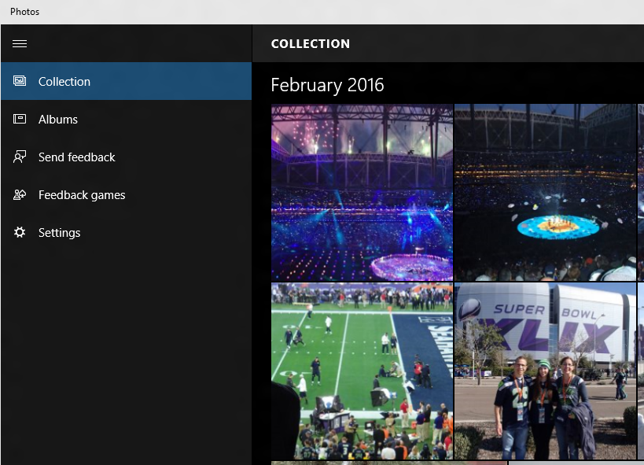
SplitView Adaptive navigation pane
<SplitView DisplayMode="Inline|Overlay|CompactInline|CompactOverlay">
<SplitView.Pane>
<!-- Navigation Content Here -->
</SplitView.Pane>
<!-- Main Content Here -->
</SplitView>

Slide 42
Simplifying Responsive View Development Triggers and Setters (XAML equivalent of Media Queries)
<VisualState.Setters>
<Setter Target="splitView.DisplayMode" Value="Inline" />
</VisualState.Setters>
<VisualState.StateTriggers>
<AdaptiveTrigger MinWindowWidth="720" />
</VisualState.StateTriggers>
<VisualState.Setters>
<Setter Target="splitView.DisplayMode" Value="Overlay" />
</VisualState.Setters>
<VisualState.StateTriggers>
<AdaptiveTrigger MinWindowWidth= "0" />
</VisualState.StateTriggers>
If the Window width is >= 720 effective pixels, then show SplitView in Inline mode

Slide 43


RelativePanel Enables elements to layout relative to other elements
<Grid>
<Grid.ColumnDefinitions>
<ColumnDefinition Width="Auto"/>
<ColumnDefinition Width="*"/>
</Grid.ColumnDefinitions>
<Image x:Name="img" …/>
<StackPanel Grid.Column="1" …>
<TextBlock x:Name="title" …/>
<TextBlock x:Name="authors" …/>
<TextBlock x:Name="summary" …/>
<Button Content="Download" …/>
</StackPanel>
</Grid>
“Traditional” nested panel layout can be challenging for more complex layouts

Slide 44
RelativePanel
<RelativePanel>
<Image x:Name="img" …/>
<TextBlock x:Name="title" RelativePanel.RightOf="img" RP.AlignTopWith="img" …/>
<TextBlock x:Name="authors" RP.RightOf="img" RP.Below="title" …/>
<TextBlock x:Name="summary" RP.RightOf="img" RP.Below="authors" …/>
<Button Content="Download" RP.RightOf="img" RP.AlignBottomWithPanel="True" …/>
</RelativePanel>
Use with Triggers and Setters for more advanced responsive designs
Note: RP above should be replaced with RelativePanel (shortened for readability)

Slide 45
XAML Performance in Windows 10

Slide 46
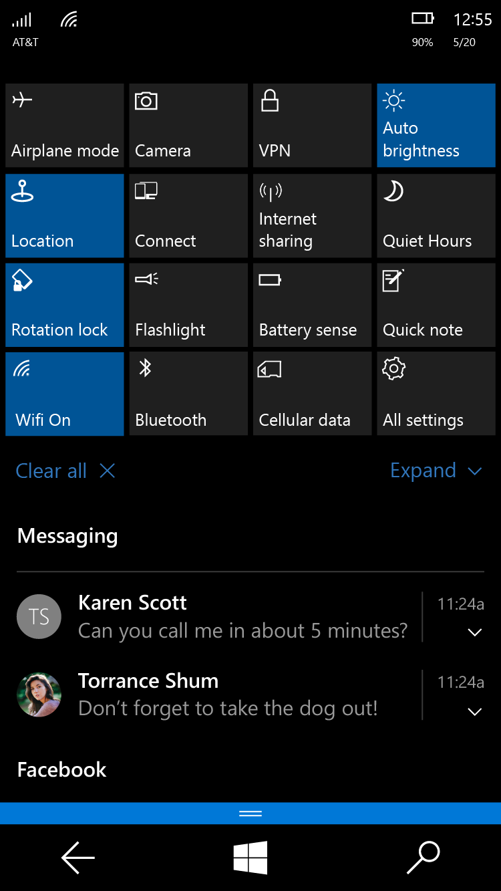
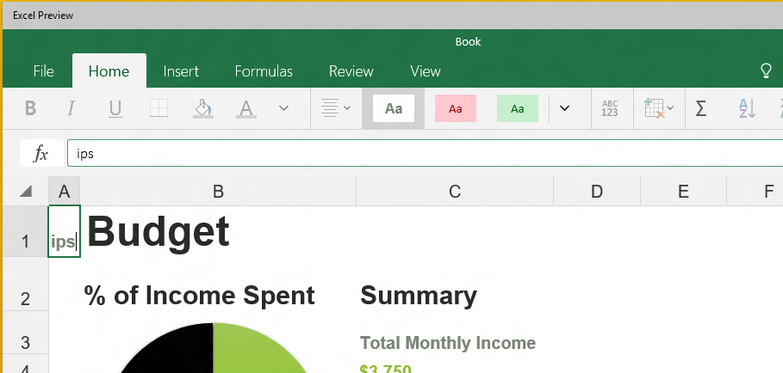
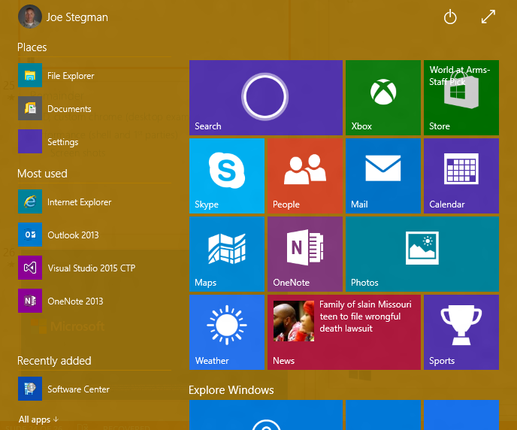
Validating XAML in Windows 10

Slide 47
Notable New Performance Features Compiled Bindings AKA {x:Bind}: Like {Binding}, only they go to 11
<ListView>
<ListView.ItemTemplate>
<DataTemplate>
<StackPanel>
<SymbolIcon Symbol="{Binding Symbol}"/>
<TextBlock Text="{Binding Name}"/>
<Button Click="Button_ClickHandler"/>
</StackPanel>
</DataTemplate>
</ListView.ItemTemplate>
</ListView>
<ListView>
<ListView.ItemTemplate>
<DataTemplate x:DataType="local:FreeBookCategory">
<StackPanel>
<SymbolIcon Symbol="{x:Bind Symbol}"/>
<TextBlock Text="{x:Bind Name}"/>
<Button Click="{x:Bind Click}"/>
</StackPanel>
</DataTemplate>
</ListView.ItemTemplate>
</ListView>
Resolved at compile time and produce compiler errors.

Slide 48
Other New UI Features

Slide 49
Change Notification on all Control Properties Technically, just the ones that are DependencyProperties
<!-- Get notifications when Button Content property changes -->
<Button x:Name="target" Content="{x:Bind Name}"/>
// Register for changes on “target.Current” property
target.RegisterPropertyChangedCallback(ContentControl.ContentProperty, ContentChanged);
// Handler
void ContentChanged(DependencyObject sender, DependencyProperty prop)
{
// Content Changed
Object content = (sender.GetValue(prop));
}

Slide 50
PerspectiveTransform3D Composable 3D Transforms (Effects: 3D Rotations, Parallax)
<Grid>
<Grid.Transform3D>
<!– Parent Camera -->
<PerspectiveTransform3D/>
</Grid.Transform3D>
<Border Background="#FF7F00">
<Border.Transform3D>
<CompositeTransform3D RotationX="-90 " …/>
</Border.Transform3D>
</Border>
<Border Background="#FF6700">
<Border.Transform3D>
<CompositeTransform3D RotationY="-90" …/>
</Border.Transform3D>
</Border>
</Grid>

Slide 51

Windowing Custom chrome, branding, sizing
<!-- XAML -->
<StackPanel x:Name="customTitleBar" Height="32" …>
<FontIcon …/>
<TextBlock Text="Belize 2015" …/>
</StackPanel>
// Remove Standard Title Bar
CoreApplication.GetCurrentView().TitleBar.ExtendViewIntoTitleBar = true;
// Indicate Custom App UI to use as the TitleBar (for move, resize)
Window.Current.SetTitleBar(customTitleBar);

Slide 52
Ink Canvas Palm rejection, smoothing, high fidelity
<Grid>
<!-- It’s this simple -->
<InkCanvas/>
</Grid>

Slide 53
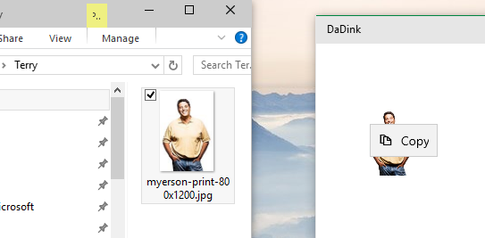
Drag and Drop Extended for “Windowed” Apps
<!-- XAML -->
<Grid AllowDrop="True" DragOver="Do_DragOver" Drop="Do_Drop" …>
…
</Grid>
File Explorer
My App

Slide 54
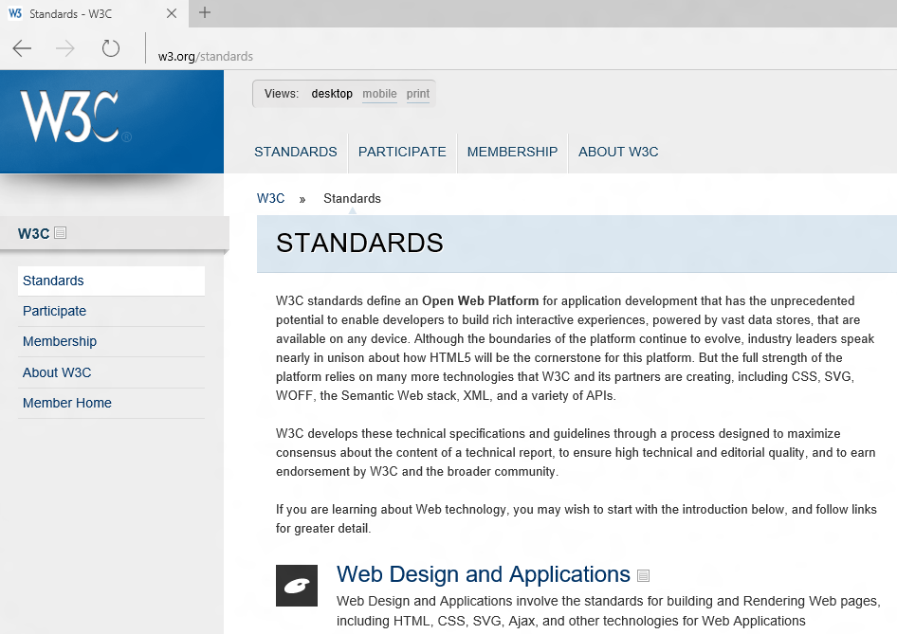
XAML WebView Enhancements
Spartan “Edge” in Windows 10
WinRT Access
And More…
See “Hosted Web” Apps session for details

Slide 55
XAML Improvements in Visual Studio

Slide 56
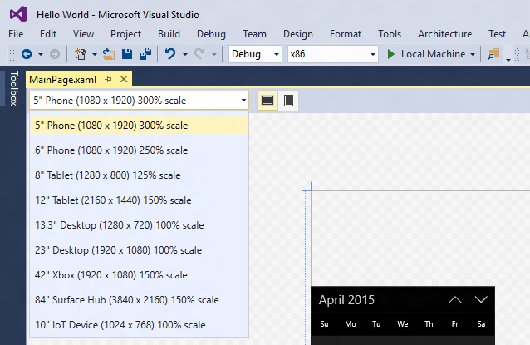
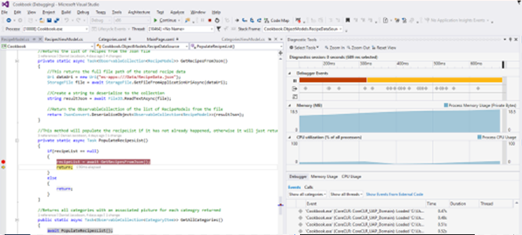
Visual Studio New design modes, performance instrumentation timeline tool and more…

Slide 57
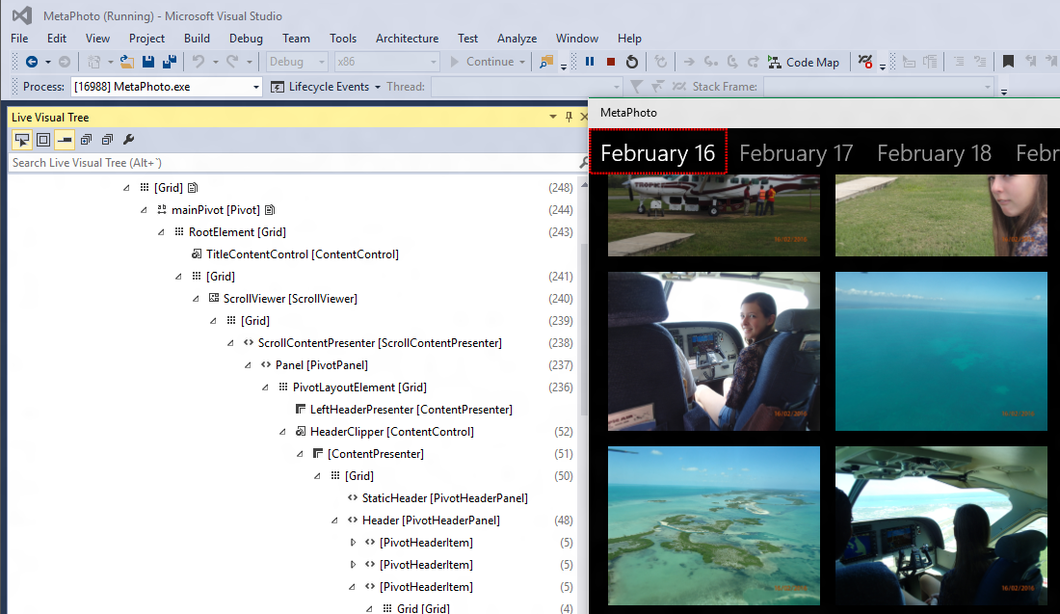
Visual Studio Visual Tree Inspector

Slide 58
And More…
CommandBar Updates
Vector Fonts
Property Change Improvements
New Content Presenter APIs
IME Composition Events
Directional Navigation
ListView Enhancements
Framework Element Loading Event
Improved Animation Experiences
Improved XAML/DX Interopability
Software Bitmap Source
Silverlight memory improvements
Printing APIs on Mobile
Improved BiDi handling
Improved ScrollViewer APIs
Casting in media elements

